Slide 1
Lecture 14:
Command Objects &
Support for Undo
05-431/631 Software Structures for User Interfaces (SSUI)
Fall, 2020

Slide 2
Logistics
Midterm exam grades and comments posted
  Please check it
  Self-reported time to finish: average = 3.5 hours; min=2, max=6
  Exam grade average = 90, min=74.5; max=96.5
  Go over answers
Midterm course grades on SIO
Please take the midterm survey by
https://www.surveymonkey.com/r/SSUI2021midterm
Homework 4 due on Thursday
This lecture is how to do HW 5

Slide 3

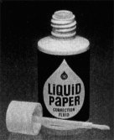
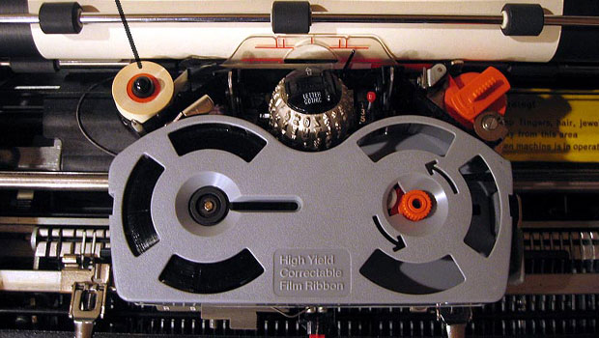
Early Undo
Invented 1951 by
Bette Nesmith Graham
IBM Correcting
Selectric II
1973

Slide 4
Computer “Undo”
Undo is reversing a previous operation so that it no longer is in effect
  Usually ^Z
  For web apps, sometimes the Back button in a browser
Cancel is stopping an operation while it is in progress
  Often ESC key or the “Cancel” button in a dialog box

Slide 5
Single Level Undo
create
green rect
resize
rect
make
blue
rotate
rect
A
B
C
D
Just toggles the
latest item on the
list
undo
A
B
C
D
undo
A
B
C
D

Slide 6
Linear Undo
create
green rect
resize
rect
make
blue
rotate
rect
1)
2)
3)
4)
5)
A
B
C
D
undo
Keep a list of all operations
Undo (^Z) goes backwards, repeatedly
Redo (^-Shift Z or ^Y) goes forwards after an undo
  Undo the undo
New operations remove anything undone – it is lost forever
X
A
B
C
D
undo
undo
X
X
A
B
C
D
undo
X
A
B
C
D
undo
redo
X
X
A
B
C
D
add
shadow
redo
E

Slide 7
Repeat
create
green rect
resize
rect
make
blue
rotate
rect
A
B
C
D
Does the previous
operation again on
the current selection
E.g., rotate something else by the same amount
  Really useful
Goes on the undo stack just like normal operations
Typically, uses same
shortcut key as Redo
  But might want to
  repeat the previous
  command after an undo
  Office changes icon
Repeat is often not available
repeat
A
B
C
D
E
create
green rect
resize
rect
make
blue
rotate
rect
A
B
C
D
undo
A
B
C
D
Repeat
make blue
E

Slide 8
Complications: Operations not put on Undo Stack
Scrolling
  Might be useful to have a “go back”, like with hyperlinks
  See research later
Changing the selection
  not undoable, doesn’t change undo stack
  My Topaz system made this available for undo – see later
Changing the value of controls, if doesn’t affect any objects
  Changing the color of the next-drawn object
Copy (as in Cut-Copy-Paste)
  Clipboard changes are not affected by undo
    Lots of clever strategies take advantage of this
    Also not possible since clipboard is global and undo is per-application
Saving to file is not undoable
  Old: blocks off all previous operations
  Current: not put on undo stack so can undo past saves

Slide 9
Complications: operations that are collected
Multiple characters typed grouped into one undo
  Similarly, multiple backspaces
Used of arrow keys to “nudge” graphics often grouped into 1 operation
Or, one operation causes multiple entries on undo stack: teh_ → the_ (auto-correct; text)

Slide 10
Undo in Various Programs
See details for how Linear Undo works in PowerPoint
  Good reference for expected behaviors
  Note how selection changes as a result of undo
Many programs have “unusual” designs for undo
  Outlook – single level; undo delete – not selected (so hard to find)
  Emacs editor – weird “switch directions” undo – forward/backwards
  PhotoShop – 2 or 3 different undo mechanisms

Slide 11
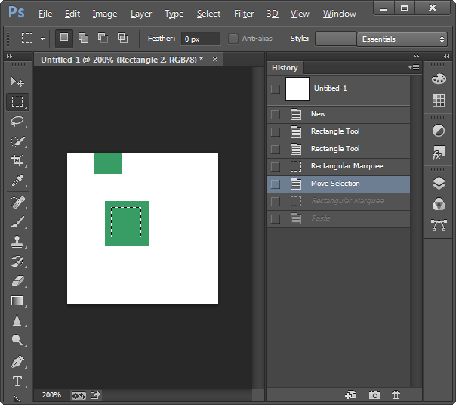
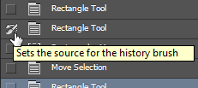
Adobe PhotoShop
History pane displays previous operations
^Z – one-level undo that toggles undo/redo – until V2019
Also Shift-^Z, Alt-^Z - linear undo forwards and backwards
  Redo list erased on new
  operations
“History brush”
  Select point in past and
  brush area – returns to
  the way it was in the past
  Can’t “skip” operations
  Is selective by region, but
  not by time

Slide 12
Undo implementations
Need a central list of operations
Where to store the old values?
  With objects that are modified
    E.g., a rectangle keeps track of all its former locations
    Called “Memento Pattern” (Wikipedia)
    But limited in kinds of editors – doesn’t work for text, paint
  In a global list
    But what to store for each operation?
  Using the Command Object pattern
    Store in the command object itself
    Then it stays with the operation
    No confusion about which parameters for which operation

Slide 13

Command Object Pattern
Wikipedia: “An object is used to encapsulate all information needed to perform an action or trigger an event at a later time. This information includes the method name, the object that owns the method and values for the method parameters.”
Was in original “Design Patterns” book (1994)
Better separation between action and widgets
Clearer place to store information needed for undo

Slide 14
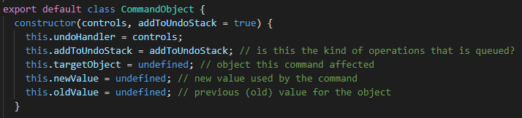
HW 5 design for Command Objects
Abstract class that all operations extend:
class CommandObject
Methods for Execute, Undo, Redo etc., that specific commands override
Variables for saved values in the command object itself

Slide 15
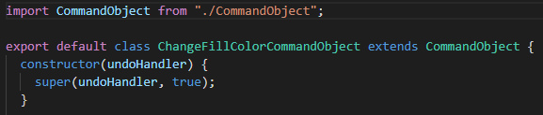
Sub-classes of command object
Create a subclass of CommandObject for each kind of command
  Also: CreateObjectCommandObject, ChangeBorderColorCommandObject, ChangeBorderWidthCommandObject, etc.

Slide 16
Standard Process for using a Command Object
When the user clicks menu item (e.g., to change color), or starts an action (like create object), allocate a new command object of the correct type
curCmd = new ChangeFillColorCommandObject(undohdlr);
Call that object’s execute() method, which will:
    Save all the information needed to undo/redo/repeat the action later
    Perform the action
    Put this command object on the undo list
  Each kind of object will have a different execute method
  What does ChangeFillColorCommandObject.execute() need to store?

Slide 17
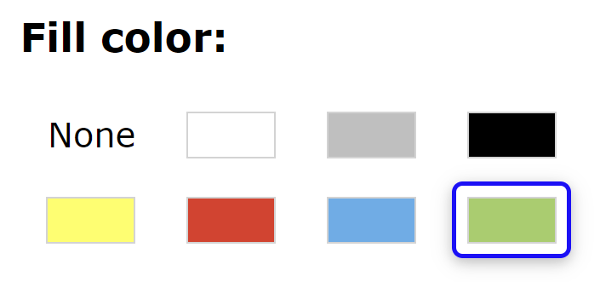
Provided Example: ChangeFillColorCommandObject
Command object that is used when
change the fill color
What to store?

Slide 18
Example:
create
green rect
resize
rect
make
blue
SVG Change fill color: C
Target object = rect1
Old value = “green”
New value = “blue”
class ChangeFillColorCommandObject extends CommandObject
A
B
C
undo
rect1

Slide 19
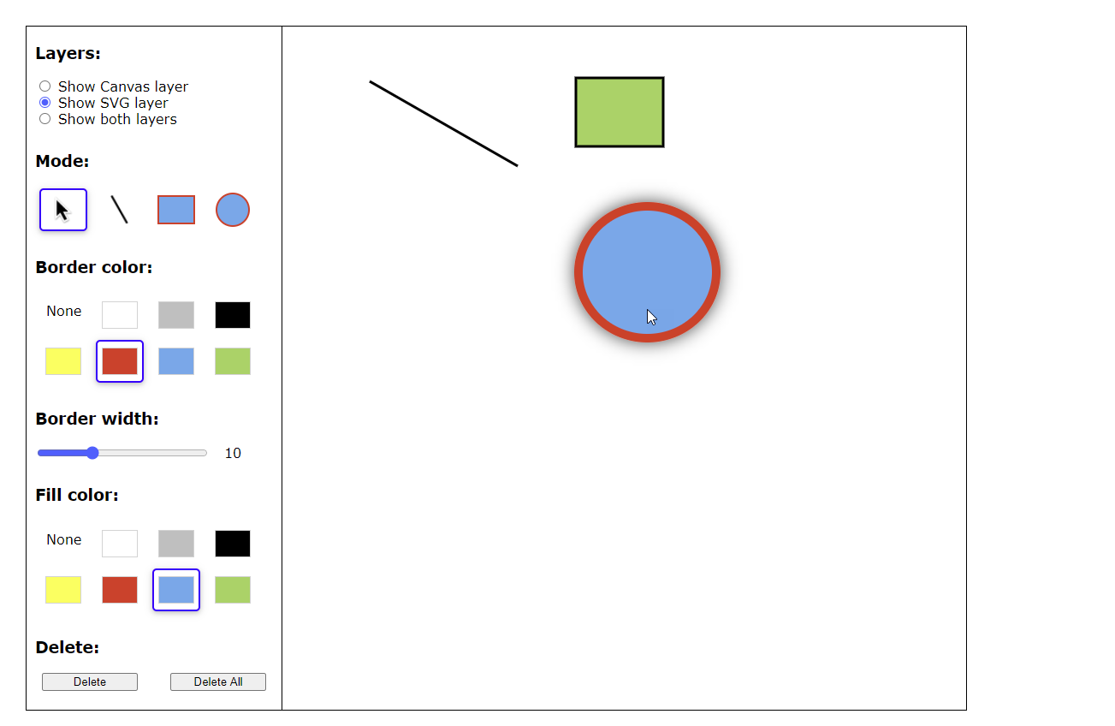
Values
newValue and oldValue often need to be an object with many values
What to store for create in HW 3?
  All values used:
    Type (line/rect/ellipse)
    Coordinates for create
    Border color
    Border width
    Fill color
  For SVG, can store the created
  object, but not for canvas
Why can’t you just get
values from the palette?

Slide 20
Command Object Methods
Execute / Do
  The actual operation of the command, like to change the fill color
  Gets parameters from the global variables and saves them in the Command Object itself
  Execute the command
  Save the command object on the undo stack
    Real operation will be a little more complicated
For ChangeFillColorCommandObject:
execute() {
if (selectedObj !== null) { // global variable for selected object
this.targetObject = selectedObj; // save the object
this.oldValue = selectedObj.fillColor; //get current color
this.newValue = fillColorWidget.currentColor; //new color
selectedObj.fillColor = this.newValue; //actually perform the change
if (addToUndoStack)
this.undoHandler.registerExecution({...this}); //load me onto undolist
// which will also potentially remove pending undone commands
}
}

Slide 21
Other Command Object Methods
canExecute() – whether the execute method will work now
  For change color – just if there is an object selected
canRepeat() – whether repeat will work now
  For change color – just if there is an object selected and a previous color
canExecute() {
return selectedObj !== null;
}
canRepeat() {
return (selectedObj !== null) && this.newValue;
}

Slide 22
Undo & Redo
Undo method – make the object have its old value
undo() {
this.targetObject.fillColor = this.oldValue;
// make sure this object is selected, which will
// also fix the palette to show this object's color
becomeSelected(this.targetObject);
** now fix the undo stack **
}
Redo = undo the undo
redo() {
this.targetObject.fillColor = this.newValue;
becomeSelected(this.targetObject);
** now fix the undo stack **
}
create
green rect
resize
rect
make
blue
A
B
C
undo
rect1

Slide 23
Repeat
Apply same color to the currently selected object
  Different object, so might have a different old color
Remember, this operation is added to the undo stack
Note: not the palette’s current color – use saved newColor
Need to allocate a new command object for repeat
repeat() {
if (selectedObj !== null) {
this.targetObject = selectedObj; // get new selected obj
this.oldValue = selectedObj.fillColor; //obj's current color
// no change to newValue – comes from operation that was copied
selectedObj.fillColor = this.newValue; //actually change
if (addToUndoStack)
this.undoHandler.registerExecution({...this});
}
C
Repeat
make blue
E

Slide 24
Change Color Control
When the user clicks on a color, that is different from the current object’s color, then:
  Create a new ChangeFillColorCommandObject
  Call its execute method

Slide 25
Implementing Undo for Canvas
How can “undraw” an operation for the Canvas?
  Note: not part of homework 5
Just have to save a copy of the canvas before each operation
  Redo can perform the operation again – do not need to store both before and after images
  Optimization – save only the parts of the screen that changed
Why not redo everything from the beginning each time?
  Too slow in realistic situations
create
green rect
create
blue rect
create
black circle
create
yellow circle
A
B
C
D
undo

Slide 26
Linear Undo Handler
Has to keep the undo stack, and keep track of which operation should be undone / redone / repeat
Methods for
  register a command object (after executed)
  doUndo – call this when user hits the undo menu item
  Undo Available? – controls greying out the undo menu item
    Just checks if there is a command on the undo stack
  doRedo, doRepeat, redo/repeat available?

Slide 27
Advanced: Selective Undo
Reach back into history and select which operation to undo
“Script model”
  As if that operation was just removed
Often unclear what this means!
create
green rect
resize
rect
make
blue
rotate
rect
1)
2a)
2b)
1x)
A
B
C
D
X
A
B
C
D
undo
X
?
A
B
C
D
create
green rect
resize
rect
make
blue
make
red
X
?
A
B
C
D
undo
Notes:
From in class discussion during lecture:
Fusion 360(a CAD software) has it implemented in a pretty cool way…it has a “timeline” at the bottom where you can go back and change things/move the order around
Here’s an image: https://encrypted-tbn0.gstatic.com/images?q=tbn%3AANd9GcR0_aZJRxR3BVD3nsj2IKml89uGhZR3cwJncA&usqp=CAU
(I put the picture above to the left of the slide.)

Slide 28

Timeline view in Fusion 360
Fusion 360 (a CAD software) from AutoDesk
  https://www.autodesk.com/products/fusion-360/blog/master-the-timeline-browser-preferences/
Provides graphical timeline for undo
Complete collection of every change made to your design
  Selective undo (“suppress”) also affects later operations that depend on it

Slide 29
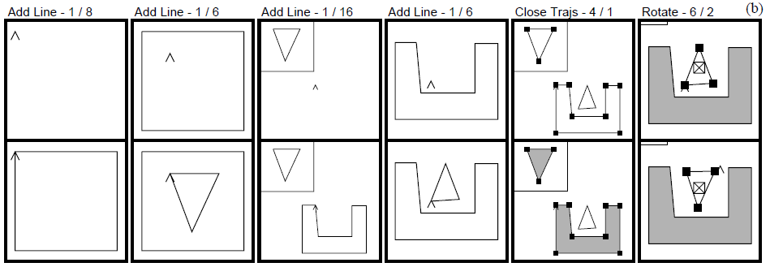
Kurlander’s Graphics Histories
Kurlander, D. and Feiner, S. Editable Graphical Histories. Proc. 1988 IEEE Workshop on Visual Languages. (Pittsburgh, Oct. 10-12, 1988). 127-134. http://ieeexplore.ieee.org/stamp/stamp.jsp?tp=&arnumber=18020&isnumber=662
Video (2:42)
Before and after scenes for each operation
Can undo back to any point
  Can then change things and redo the operations afterwards
  Basically, the “script” model of undo/redo

Slide 30


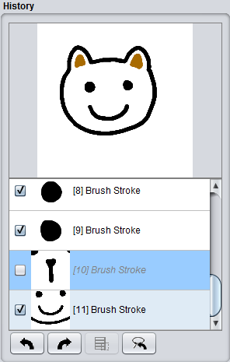
Aquamarine
Brad A. Myers, Ashley Lai, Tam Minh Le, YoungSeok Yoon, Andrew Faulring, Joel Brandt, "Selective Undo Support for Painting Applications", Proceedings CHI'2015: Human Factors in Computing Systems, Seoul, Korea, April 18-23, 2015. pp. 4227-4236. http://dl.acm.org/citation.cfm?doid=2702123.2702543
Allowing Quick Undoing of Any Marks And Repairs to Improve Novel Editing
Selective undo of past operations in a paint program using the script model
  Can’t use inverse model in paint because can’t change affected pixels in current context
  No dependencies among objects as there are in a drawing program
  Issue: spatial dependencies:
    Copy and paste
    Flood fill (paint bucket)
Short Video: 0:30
Video: 4:35

Slide 31
Selective Undo by Region
Selective Undo by Region
  Regular linear undo but only for operations in the region
  Avoids the ambiguities
  Available in PhotoShop, our research system for code editing in Azurite:
  YoungSeok Yoon and Brad A. Myers. “Supporting Selective Undo in a Code Editor,” 37th International Conference on Software Engineering, ICSE 2015. Florence, Italy, May 16-24, 2015. 223-233 (volume 1). pdf and video.

Slide 32


Region Conflicts: Flood Fill
Can still have region conflicts
  Actions at same place will do different things
Draw some lines
Paint-bucket (flood fill) the area in between
Undo one of the lines in step 1
→ Paints entire background

Slide 33

Direct Selective Undo or Inverse Model
Gina:
Thomas Berlage. “A Selective Undo Mechanism for Graphical User Interfaces Based on Command Objects,” ACM Transactions on Computer Human Interaction. Sep, 1994. vol. 1, no. 3. pp. 269-294.
Perform inverse of selected operation
Put at end of undo stack
Almost anything can be undone
Meaning determined by what is “useful” and appropriate
create
green rect
resize
rect
make
blue
rotate
rect
1)
2a)
2b)
1x)
A
B
C
D
undo make
blue = green
undo
A
B
C
D
C’
undo create
= delete
undo
A
B
C
D
A’
create
green rect
resize
rect
make
blue
make
red
undo make
blue = green
undo
A
B
C
D’
C’

Slide 34
Direct Selective Undo Implementation
Implementing direct selective undo not much harder than regular undo:
  Allocates a new command object and adds to end of history list
  Semantics is based on what the user would want
  Undo the operation in a new context means to set the object back to its previous value
  Selective Undo is enabled if object is still available
  Undo of create is delete
Redo the operation means to set the value of the object again;
  redo of create = a new object
Repeat = redo on new object

Slide 35

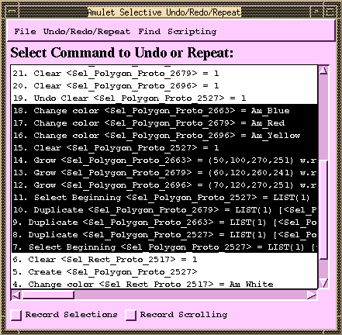
Scripting = “Topaz”
Brad A. Myers. "Scripting Graphical Applications by Demonstration," Proceedings
CHI'98: Human Factors in Computing Systems. Los Angeles, CA, April 18-23, 1998.
pp. 534-541. ACM DL, or local pdf, and YouTube video or local video (3:09).
(Topaz)
Select set of commands and specify that in a program
Uses selective repeat
Can parameterize actions
Moving which object selected is recorded
  Forwards, backwards, left, right, up, down,
  in, out
  Search for object of a particular type or value
Little or no change to application if it
supports Selective Repeat

Slide 36
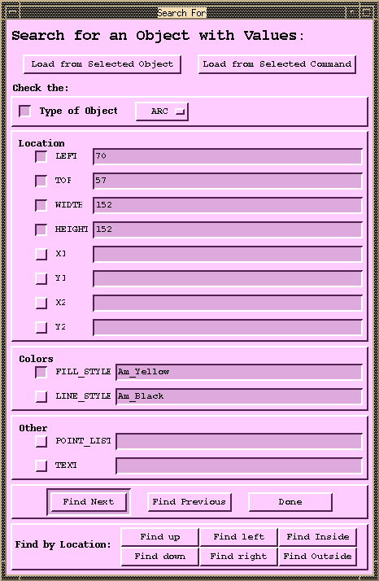
Pictures for Scripting:
Object Search

Slide 37
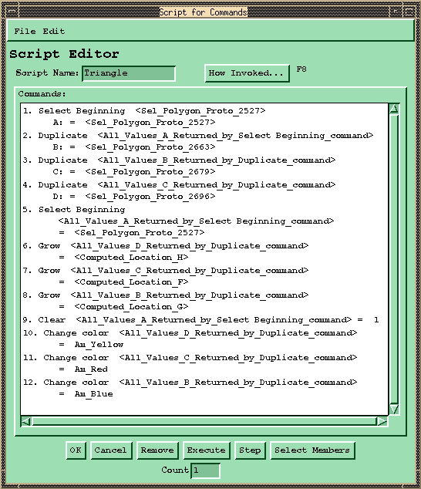
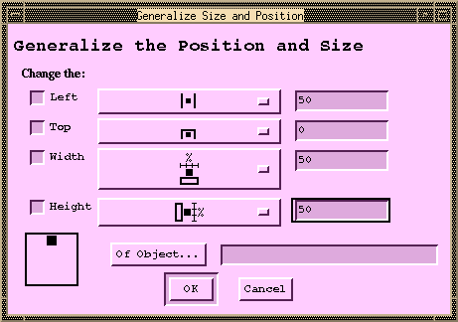
Pictures for Scripting:
Generalize Position / Size

Slide 38
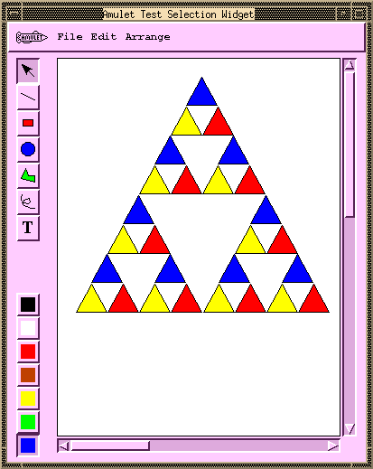
Pictures for Scripting: Result

Slide 39
Multi-User Undo
Required for Google Docs
  Let’s try: https://tinyurl.com/SSUIUndo
if multiple users have overlapping selection regions and one user does Undo – what should be done?
  Undo the globally last operation
  Undo that user’s last operation
  Undo the last operation in the region of the user’s cursor
Google Doc is somewhat random
Old research on correct ways to handle this
  Summary: it’s complicated for text, easier for graphics

Slide 40
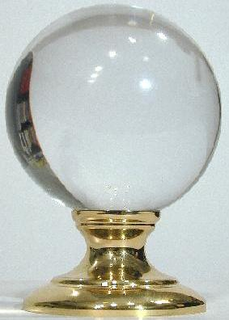
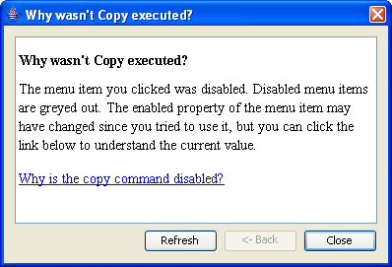
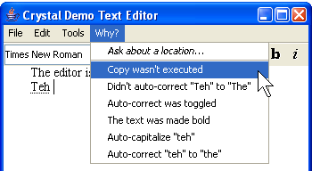
Using Undo History for “Why” Help
Crystal: Clarifications Regarding Your Software using a
Toolkit, Architecture and Language
Brad Myers, David A. Weitzman, A.J. Ko, and Duen Horng Chau, "Answering
Why and Why Not Questions in User Interfaces," Proceedings CHI'2006:
Human Factors in Computing Systems. Montreal, Canada, April 22-27, 2006.
pp. 397-406. pdf. See also YouTube or local video
Help answer why things happen in regular desktop applications
Lots of complexity in powerful features that people generally like
Ask “Why” about what recently happened

Slide 41
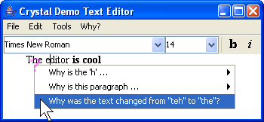
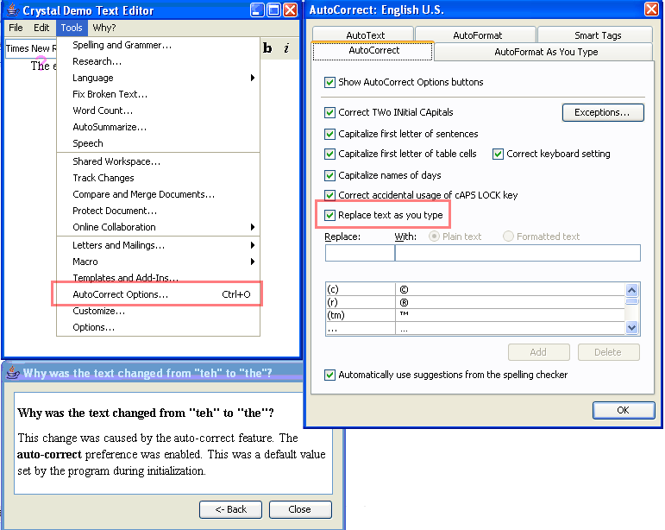
Crystal
Or, ask Why about a location by clicking on objects, or whitespace
Also can explain
complexities like
style inheritance,
etc.

Slide 42
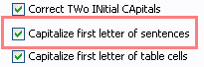
Crystal Implementation Overview
(Full details in the paper)
Only a little more work than supporting Undo
“Command object” architecture for actions
  Command objects stored on a list for undo
Programmer adds back pointers from objects to the commands that changed them
Add dependency information for mode
variables
Add special commands for actions not executed
Add extra invisible objects for whitespace and deletions

Slide 43
Crystal Implementation, cont.
Crystal framework then builds Why menus and answers automatically
Crystal finds:
  Objects under the mouse
  Commands that affected those objects
  User interface controls involved in those commands
Programmer can annotate some commands to not include in menus
  E.g., regular typing
  Similar to heuristics for granularity of Undo

